Slide 1
Building a Modular 3D Human
Model using Game Engine​

Slide 2

Work-let Name: Building Modular 3D Human Model using Game Engine
Worklet Details
Worklet ID: RSG26IIITK
College Name: IIITDM, Kurnool
.
KPIs achieved till now
I . Till Now we created a 3D Human structure
By using cubes and by importing the 2D images into
the software.
II . Developed different hair styles on the human model by using the blender software.
III . Attached a different light sources
Any Challenges/ Issues faced
I . While Adding a hair it is difficult to attach at exact
position and
the styles which were to add is some what irritating one.
II . And while combing the hair of required style
is difficult to face.
Next Steps
We will try to improve the
I . Eyebrows and Facial Hair styles.
II. Change in skin tone.
Key Achievements/ Outcome till now
Created a complete human model with cubes
and also by importing the image and and
added a hair styles to them
Date: 27-03-2023

Slide 3
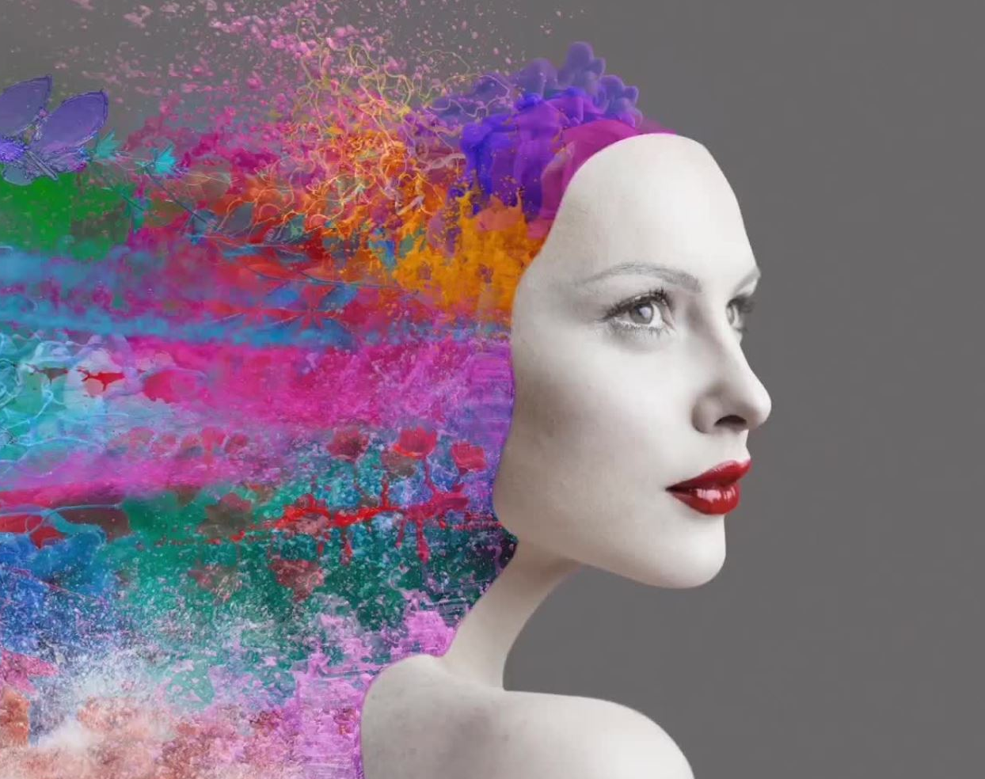
Month 2 Mianly Concentrate on the Hair styles and lighting Effect:
I . Intially image of a particular person should be imported into blender software.
II . Add the plane into the environment and rotate and scale according to the picture in any one view like ( front view or side view )

Slide 4
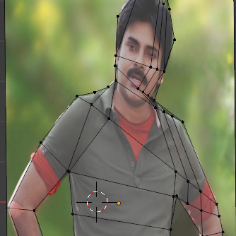
By using the wireframe the image from the main source will be determined using dots as shown in figure.
Then after by using the scale , grab and extrode funnctions we can extend the model into different dimensions.

Slide 5
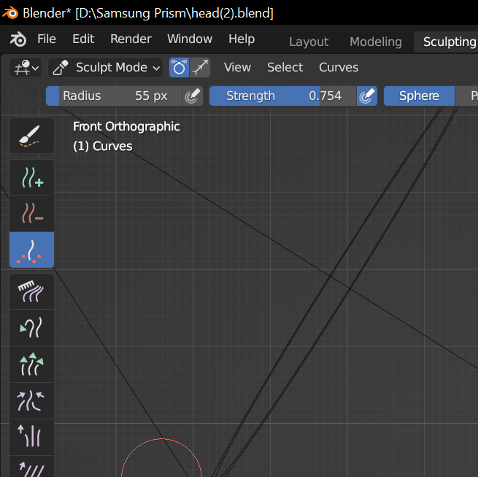
By using the sculpt Mode We can get the different options as shown in figure.
From this
Add the Hair
Remove Hair
Increase the density of hair
Comb the hair
Increase length of hair
Follow certain patterns in hair

Slide 6
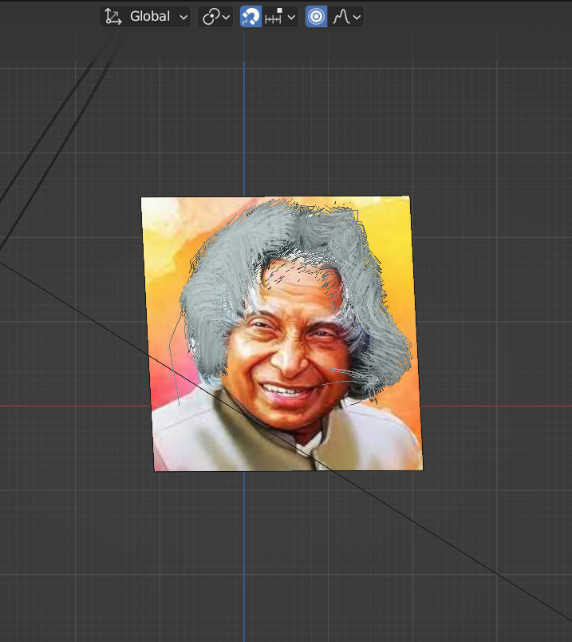
This is the final output where we added the hair and combed into different angles and changed into required type of frame.

Slide 7
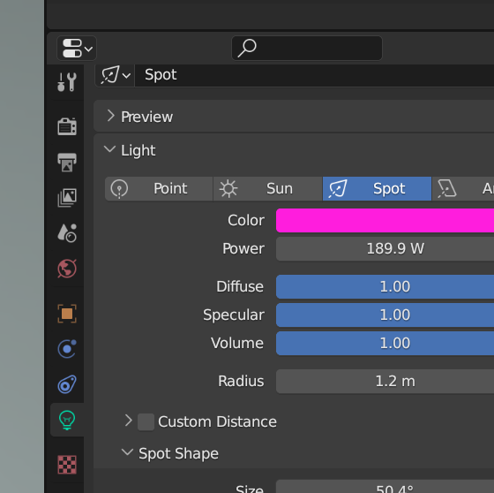
Now By using light we can vary the hair style and entire body by changing with light focus like
Spot light
Sun light
Point Light
Area Light

Slide 8
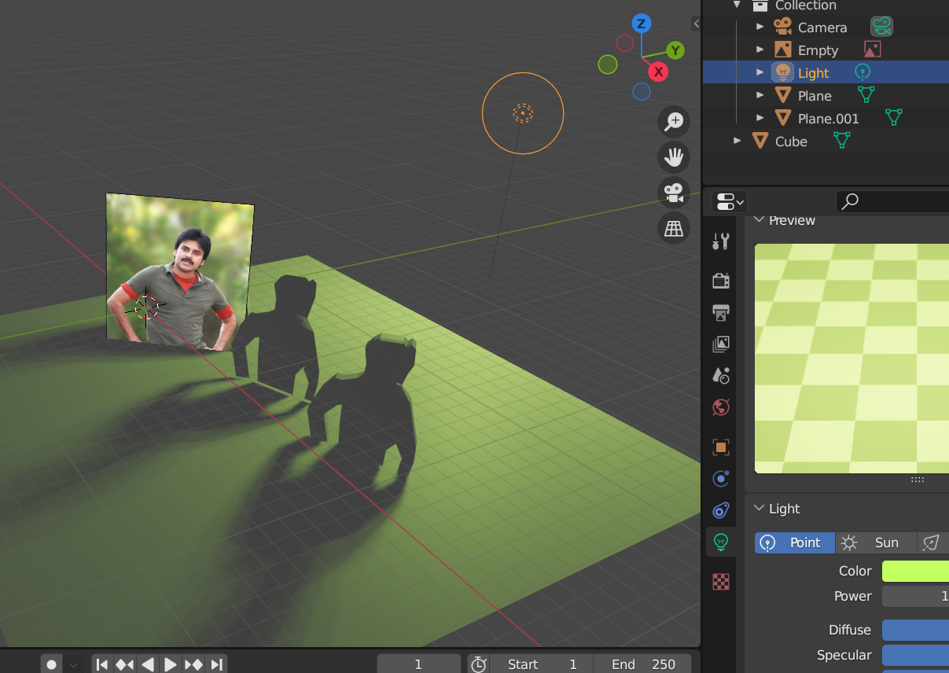
This is how spot
light will look likes when observe from different views

Slide 9
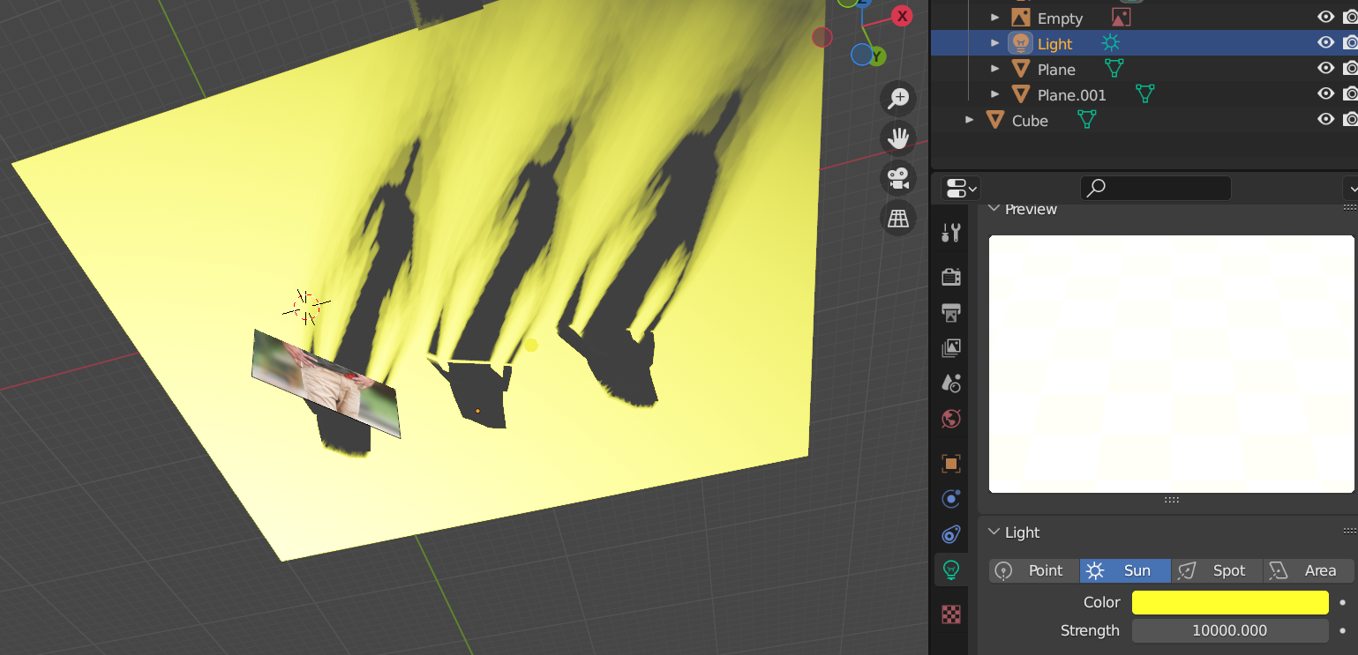
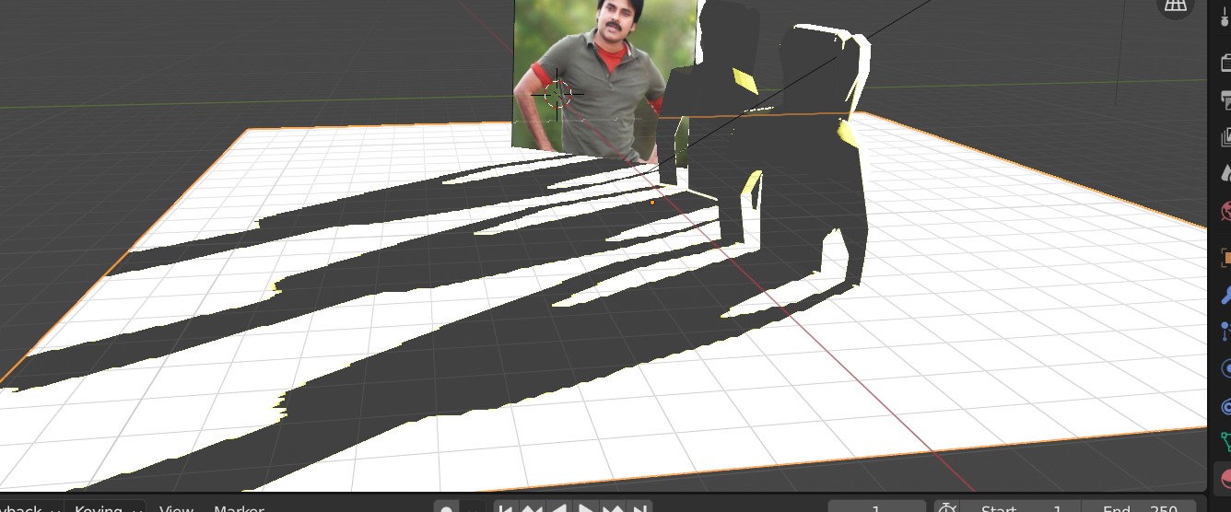
Sun Light Back view:
Sun Light Front view
​

Slide 10
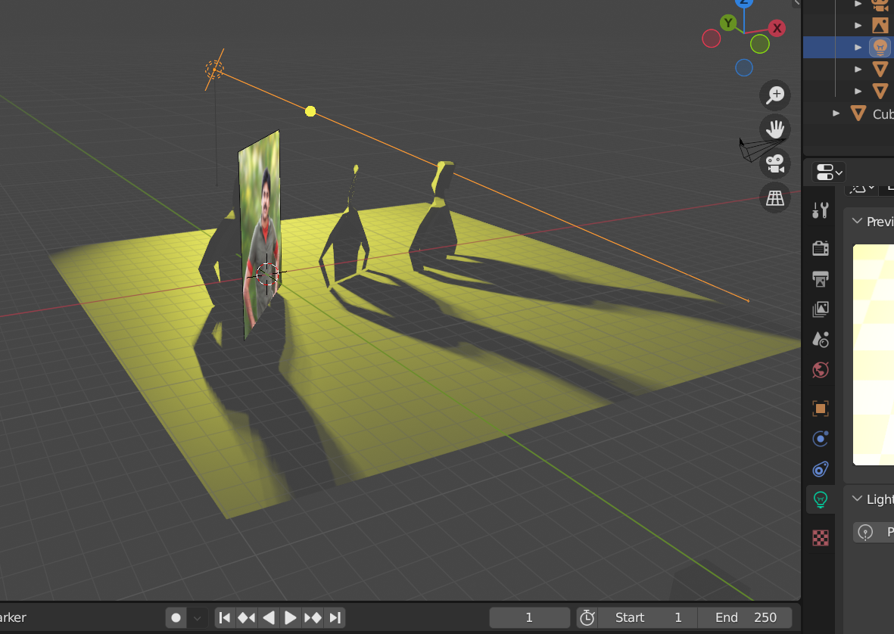
Area light with
ellipse shape

Slide 11
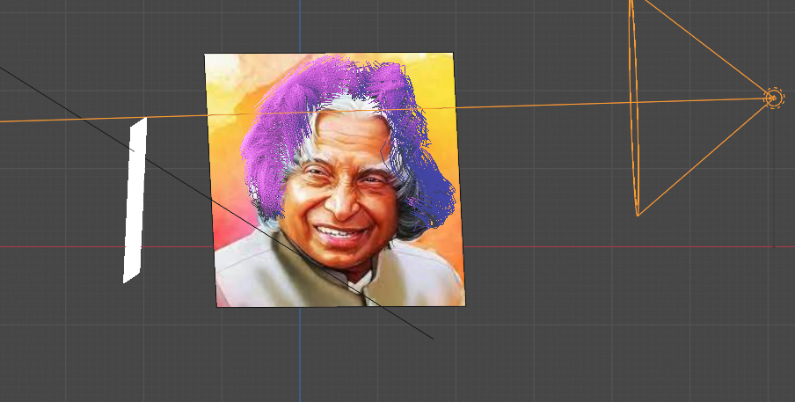
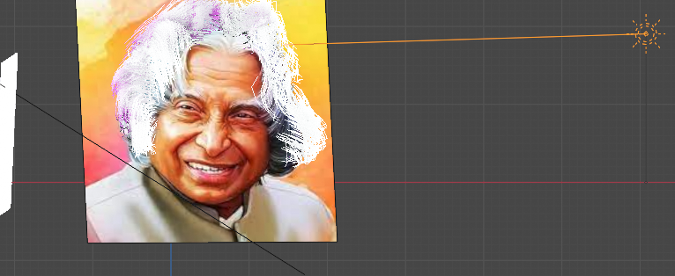
Observe the change in hair colour :
Rendering of the image
After Rendering of the image​

Slide 12
Thank You
Mentors:
D.V.L.N Somayajulu
J. Krishnaiah
Students:
P Jagadeesh
G Nagendra Babu
M Deepika

